Slide 1

Design of FMCW Radar Based on Software Defined Radio with GNURadio for Detection, Range Estimation, and Velocity of an Object
Bima Pancara Haryono Putra
1101210528
Notes:
For the next Few minutes .... By the end of this presentation, you’ll get a bit more understanding...

Slide 2
Outline
Introduction
Literature Review
System Model and Design
Simulation
Notes:
We will divide this presentation into 3 Main Section Introduction will talk about what ...
Literature Review where we will go into the topic in a bit more ....
System Model and Design where I will show the design based on

Slide 3
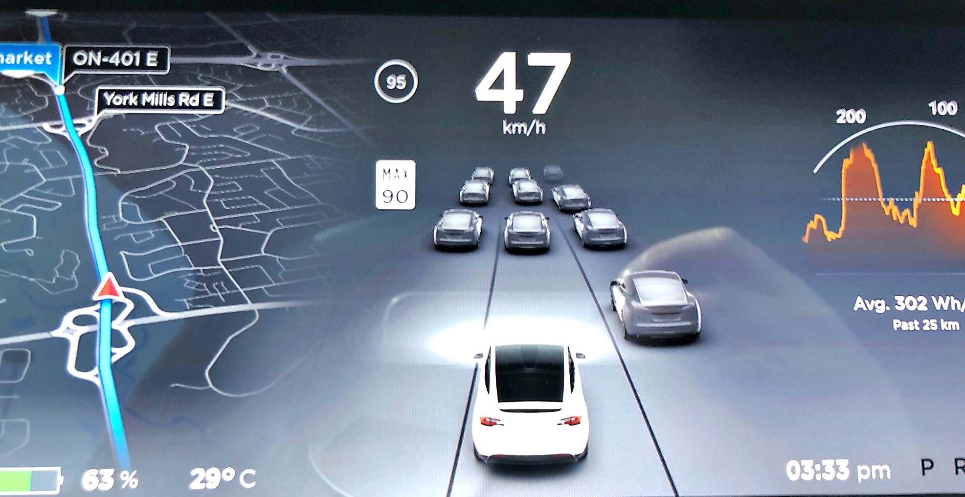

Sensing The World Through Sensor Technology
Notes:
INTRODUCTION
Sensing is important in digital era
Giving value to something in reality and define it in Digital realm

Slide 4
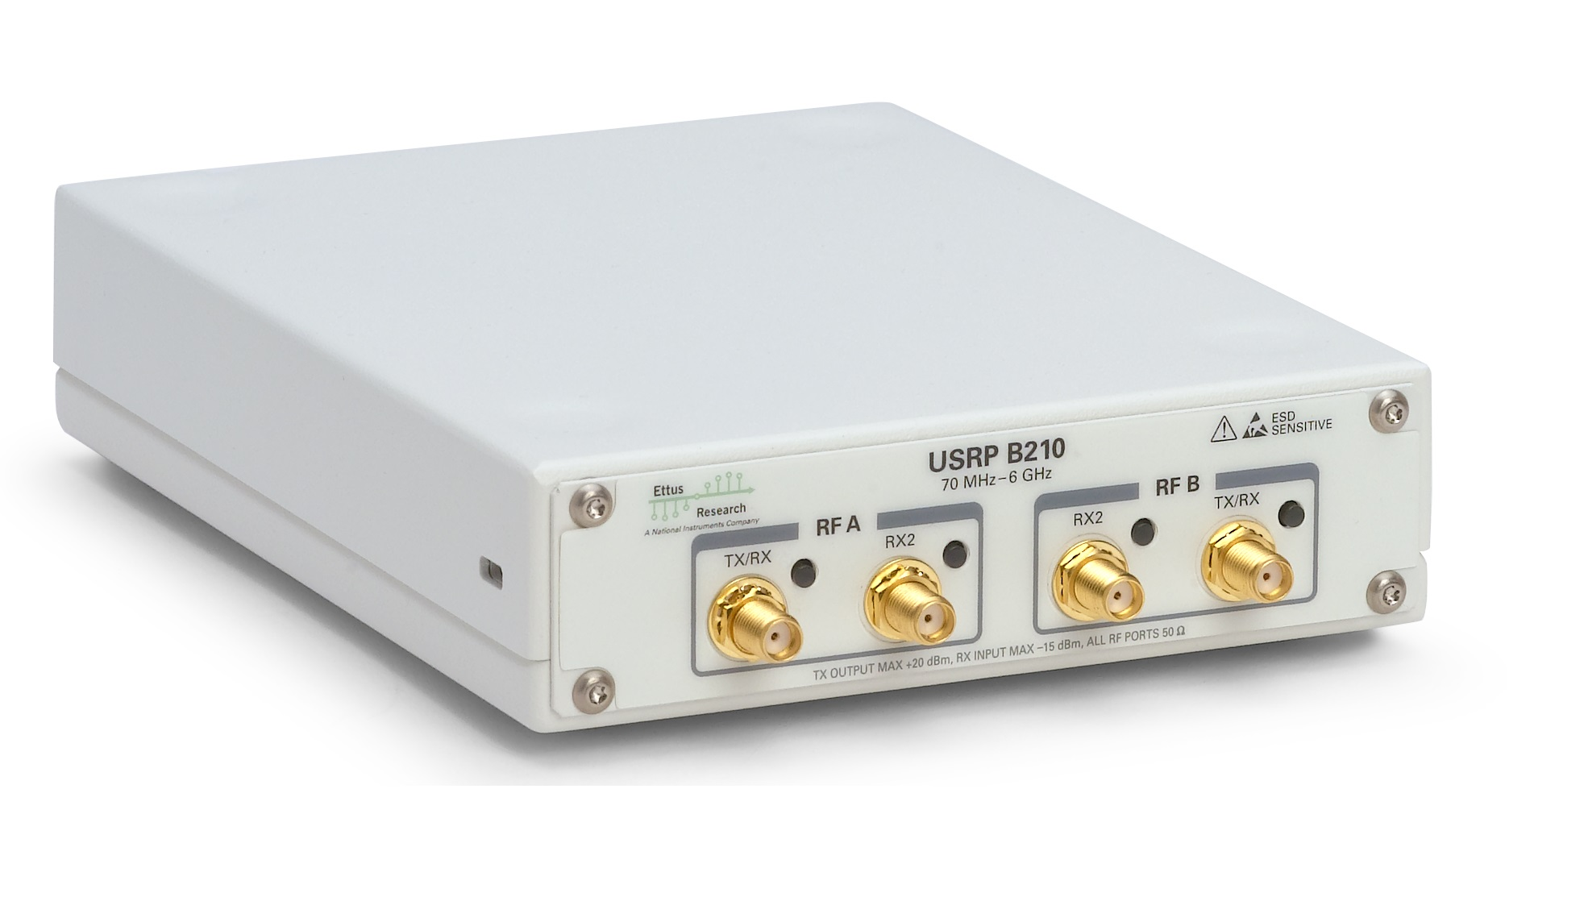


Notes:
The easier way to prototype now is using Software Defined Radio
A combination of GNURadio and USRP

Slide 5
Primary Goals
To Design FMCW Radar system based on USRP B210 with GNURadio.
To assess the detection, range estimation, and velocity of an object from the designed system.
To know the accuracy of detection, range estimation, and velocity of an object from the designed system.
Notes:
Thus, primary goals that I want to achieve by the end of this research ...

Slide 6
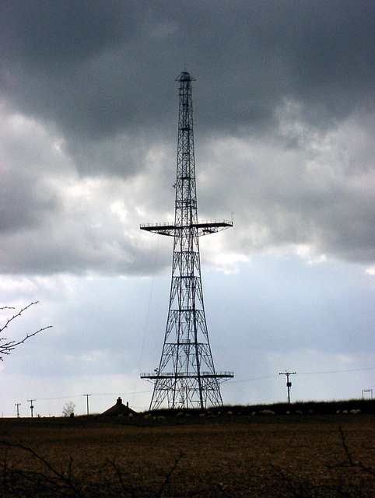
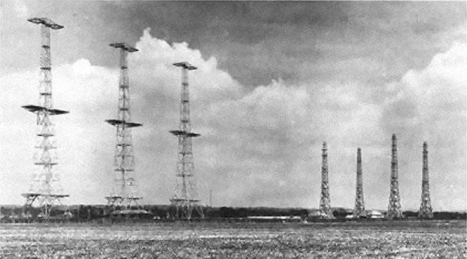
RAdio Detection And Ranging
Chain Home at RAF Poling, West Sussex
Notes:
LITERATURE REVIEW
Radar stands for ....
Funny history where german death ray
Robert Watson Watt in UK

Slide 7
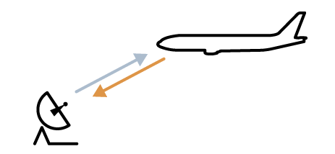
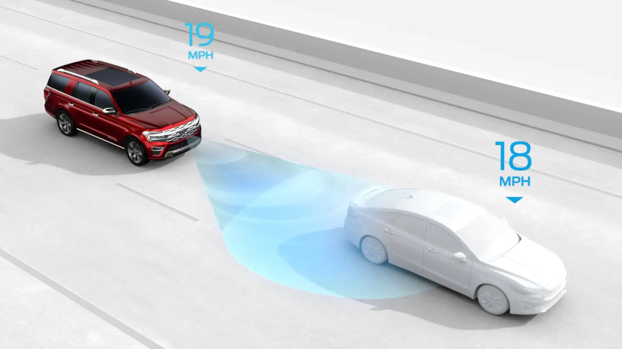
Notes:
Civillian use...
Air traffic control
Radar to detect

Slide 8
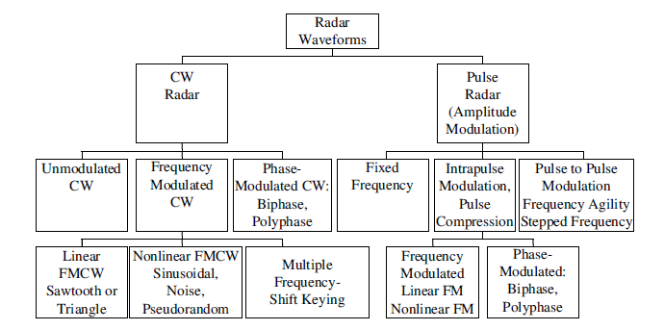
Notes:
Two main types

Slide 9
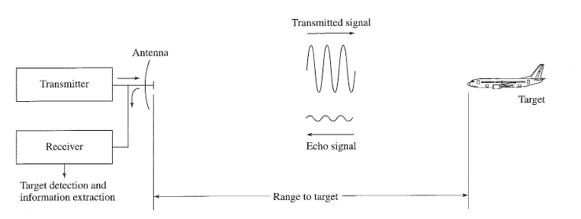
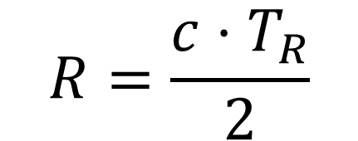
$$R=\frac{c⋅T_{R}}{2}$$
Notes:
In a pulse wave radar
But, downside is...

Slide 10
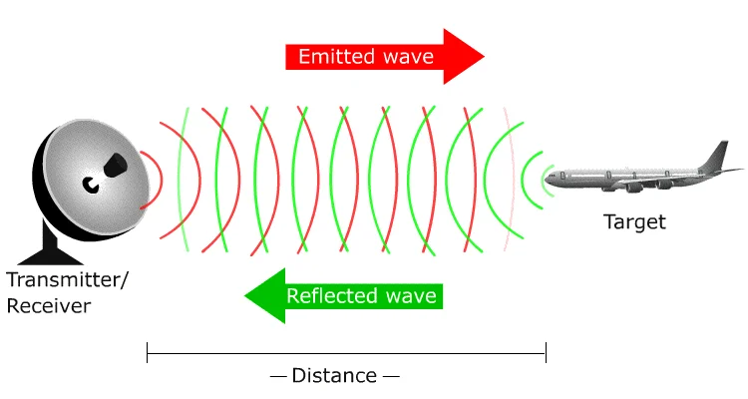
Notes:
In a contiunuous wave radar
But we can’t mark the start

Slide 11
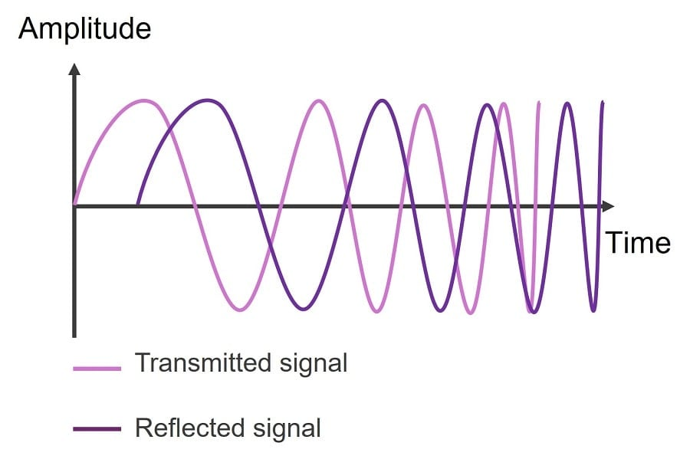
Notes:
Frequency Modulation...

Slide 12
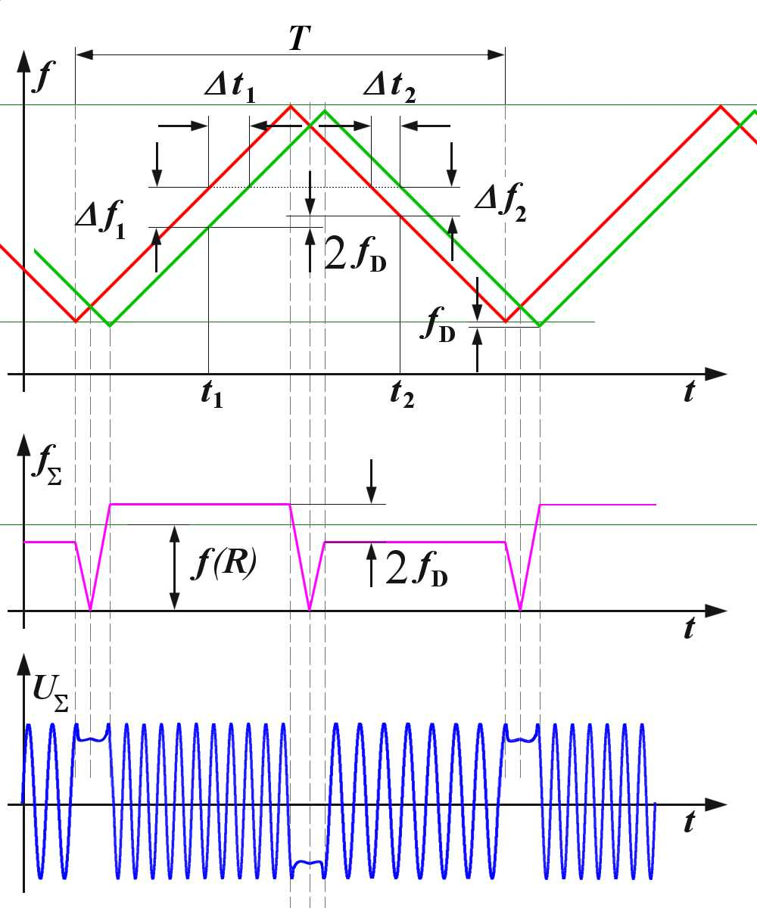
Notes:
This is how we can analyze it
multiply

Slide 13
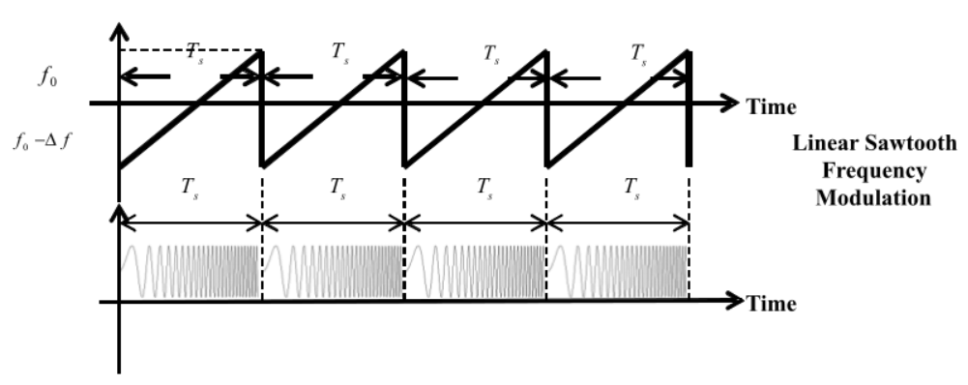
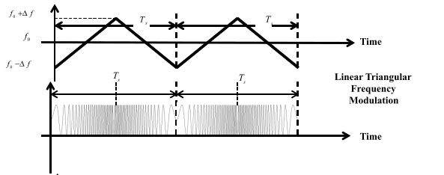
Notes:
types

Slide 14
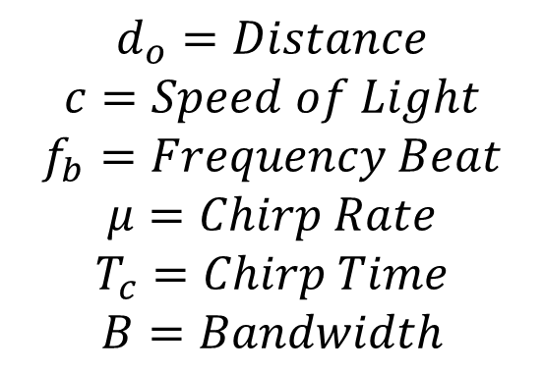
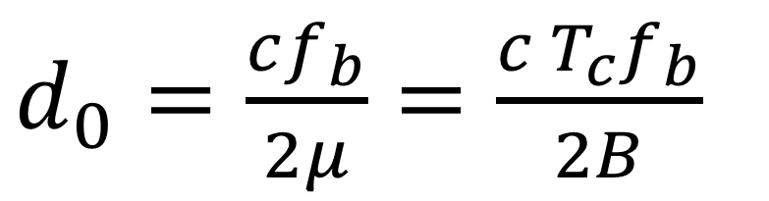
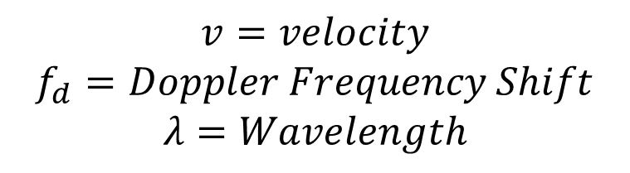
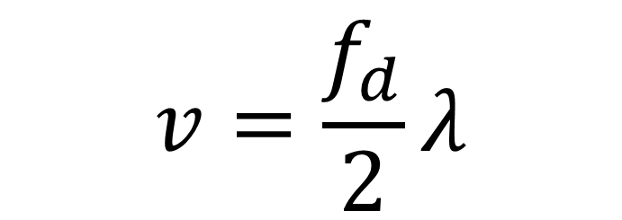
$d_{0}=\frac{cf_{b}}{2μ}=\frac{c T_{c}f_{b}}{2B}$
$$v=\frac{f_{d}}{2}λ$$
$$d_{o}=Distance$$
$$c=Speed of Light$$
$$f_{b}=Frequency Beat$$
$$μ=Chirp Rate$$
$$T_{c}=Chirp Time$$
$$B=Bandwidth$$
$$v=velocity$$
$$f_{d}=Doppler Frequency Shift$$
$$λ=Wavelength$$

Slide 15
Software Defined Radio
Notes:
Combination of GR and USRP

Slide 16
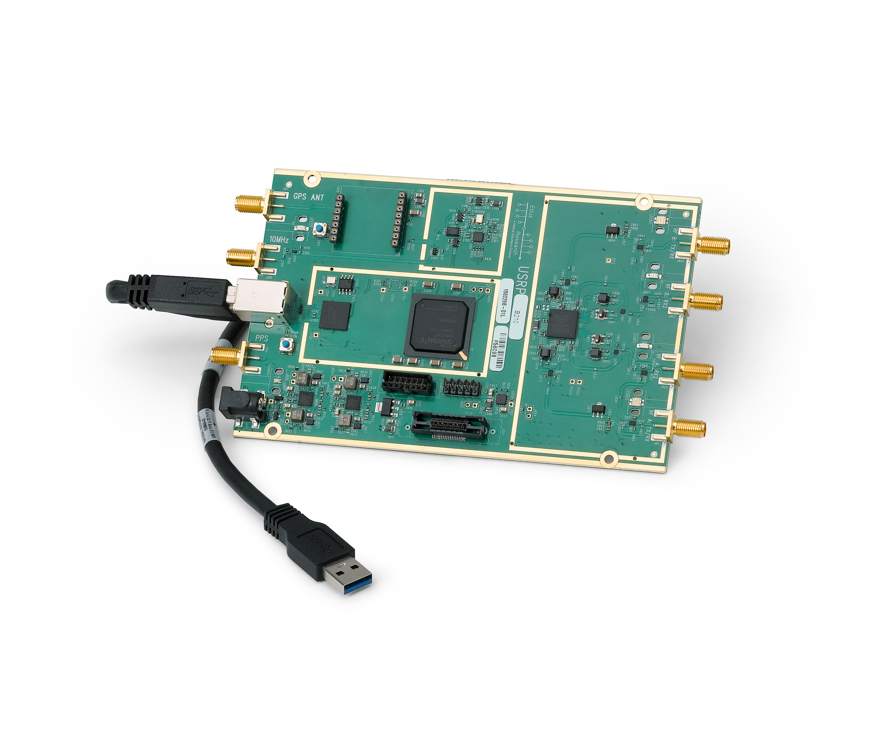
Universal Software Radio Peripheral
Notes:
USRP stand

Slide 17
No. | Description | Value | Unit
1. | RF Coverage | 70 – 6 | MHz – GHz
2. | Analog to Digital Converter Sample Rate | 61,44 | MS/s
3. | Analog to Digital Resolution | 12 | bits
4. | Analog to Digital Wideband SFDR | 78 | dBc
5. | Digital to Analog Converter Sample Rate | 61,44 | MS/s
6. | Digital to Analog Resolution | 12 | bits
7. | Host Sample Rate (16b) | 61,44 | MS/s
8. | Frequency Accuracy | ± 2,0 | ppm
9. | W/ GPS Unlocked TCXO Reference | ± 75 | ppb
10. | W/ GPS Locked TCXO Reference | < 1 | ppb
Notes:
Specification

Slide 18
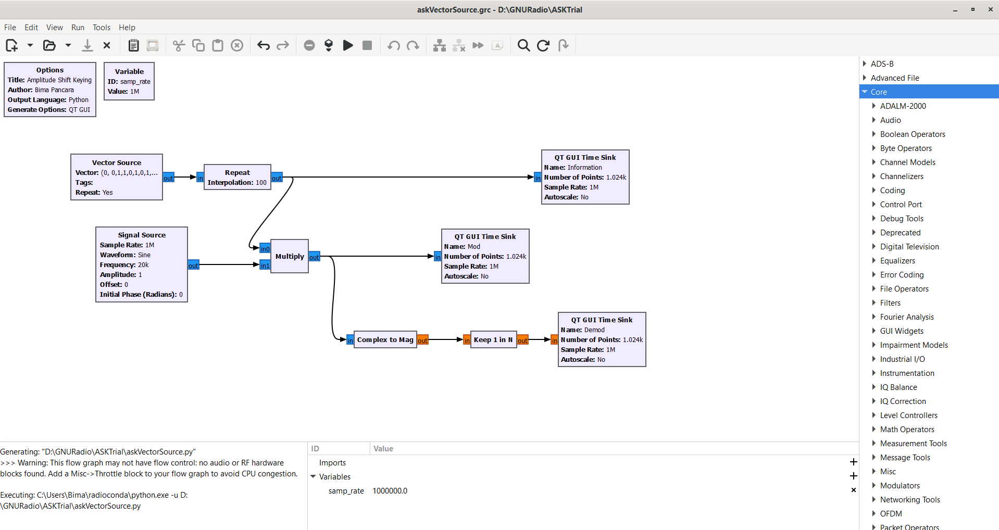
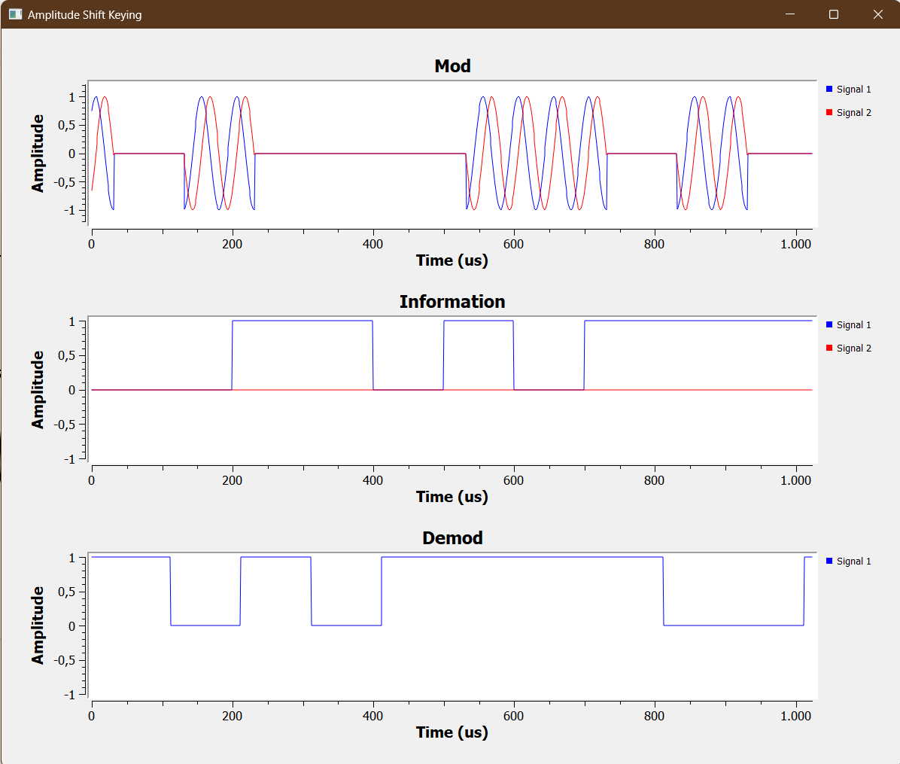

Slide 19
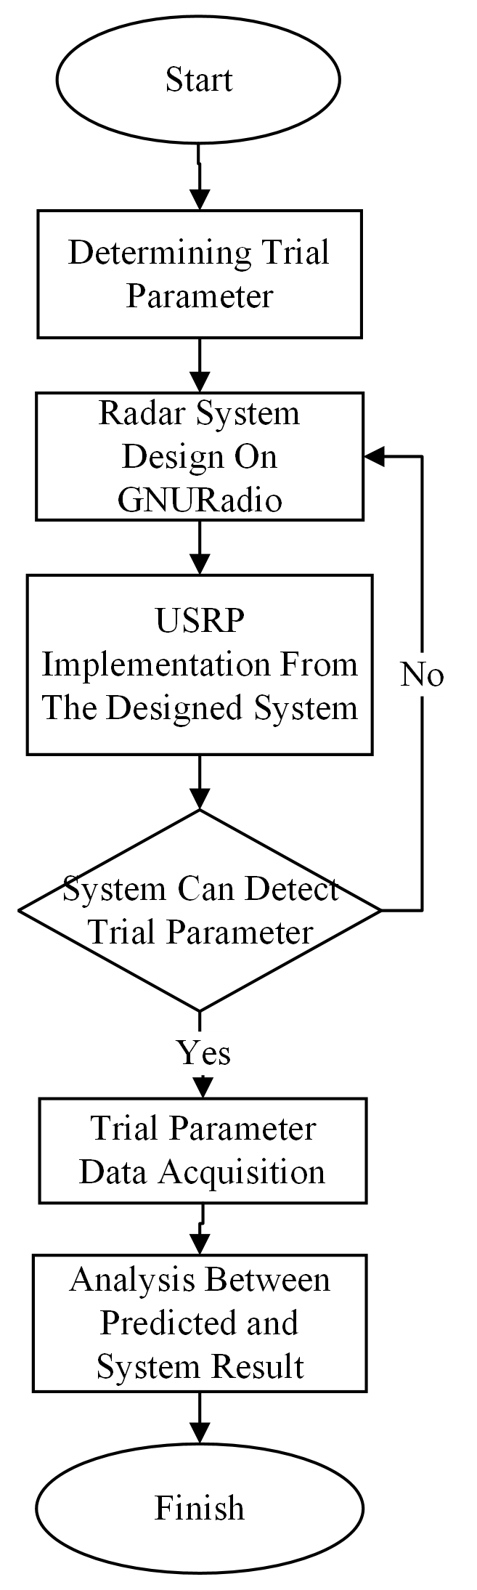

Slide 20
Trial Parameter
Range | m
Velocity | m/s
RMSE | -
Predicted Beat Frequency | Hz
Predicted doppler frequency shift | Hz

Slide 21
No. | Spesification | Description
1. | USRP | B210
2. | Carrier Frequency | 3100 MHz
3. | Bandwidth | 50 MHz
4. | Sampling Frequency | 30 MHz
5. | Modulation | Triangular
6. | Maximum Range | 145,16 m
7. | Range Resolution | 3 m
8. | Maximum Velocity | 15 m/s
9. | Velocity Resolution | 1 m/s
10. | Chirp Time | 1613 µs
11. | Chirp Rate | 0,031 MHz/µs
12. | Frame Duration | 48 ms
Notes:
Nyquist – Shannon Sampling Theorem
Sample rate need

Slide 22
No. | Spesification | Description
1. | USRP | B210
2. | Carrier Frequency | 3100 MHz
3. | Bandwidth | 50 MHz
4. | Sampling Frequency | 30 MHz
5. | Modulation | Triangular
6. | Maximum Range | 145,16 m
7. | Range Resolution | 3 m
8. | Maximum Velocity | 15 m/s
9. | Velocity Resolution | 1 m/s
10. | Chirp Time | 1613 µs
11. | Chirp Rate | 0,031 MHz/µs
12. | Frame Duration | 48 ms
Notes:
Nyquist – Shannon Sampling Theorem
Sample rate need

Slide 23
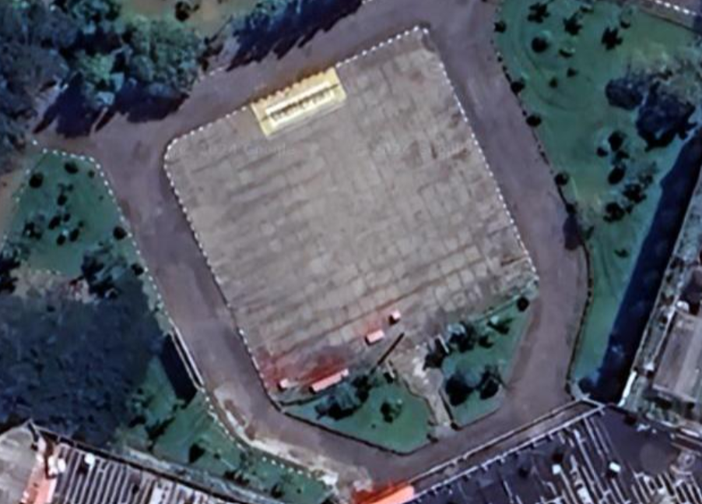
Experiment Site
Notes:
Telkom university Surabaya Field

Slide 24
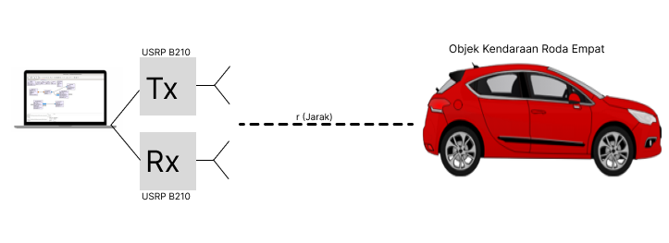
Experiment Scheme

Slide 25
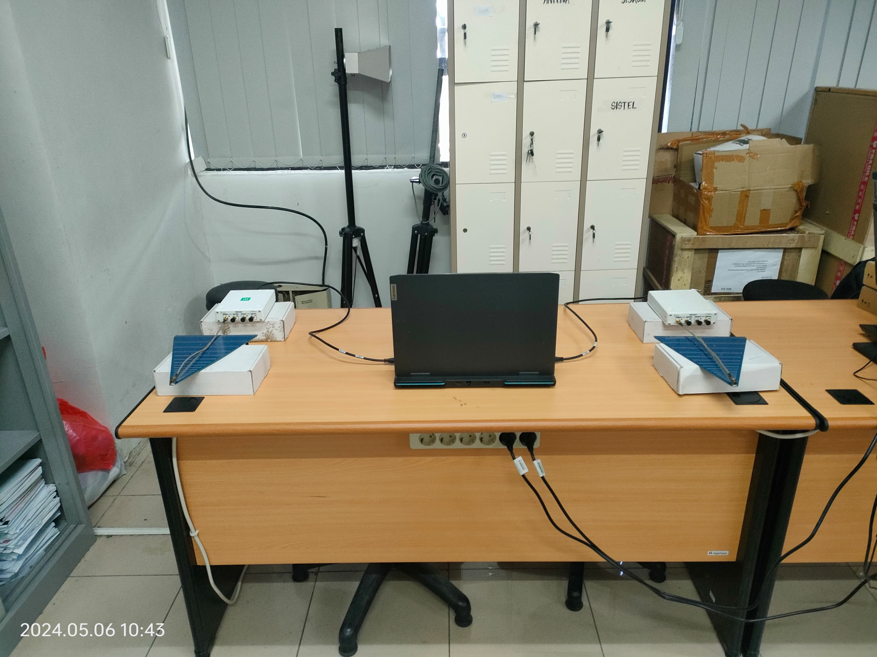
Experiment Configuration

Slide 26
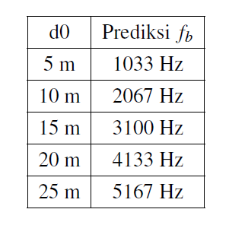
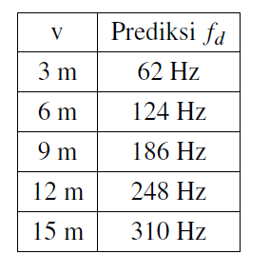
Predicted Value

Slide 27
Contribution
Test the accuracy of FMCW Radar design with GNURadio and implemented in B210 USRP to detect, range estimation, and velocity of an objet
As a reference on the implementation of FMCW Radar using B210 USRP
Notes:
Next, Simulation

